Slide 1

THE ART OF POSSIBILITY
BE YOUR BEST YOU!

Slide 2

A shoe factory sends two marketing scouts to a region of Africa to study the prospects for expanding business. One sends back a telegram saying,
“SITUATION HOPELESS! STOP! NO ONE WEARS SHOES!”
The other writes back triumphantly,
“GLORIOUS BUSINESS OPPORTUNITY! STOP! THEY HAVE NO SHOES!”

Slide 3

Here are 12 practices listed by Benjamin Zander in his book The Art of Possibility to help you shift your perspective and open new possibilities for your life.
Is your glass half empty or half full?
You may not be able to change the circumstances you’re facing but you can change how you deal with those situations.

Slide 4

1. Remember it’s all invented.
When you are looking at a problem, all the assumptions you make about it are in your mind. A problem is not simply a half-story you tell yourself, but rather something you make up entirely.
“The frames our minds create define – and confine – what we perceive to be possible. Every problem, every dilemma, every dead end we find ourselves facing in life, only appears unsolvable inside a particular frame or point of view.
Enlarge the box, or create another frame around the data, and problems vanish, while new opportunities appear.”

Slide 5
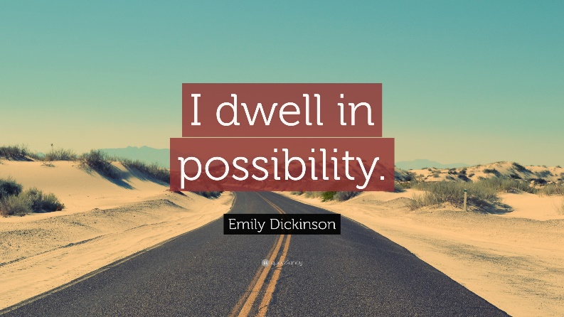
2. Step into a universe of possibility.
Imagine no limitations exist; the universe is abundant, open and infinite.
If you have an attitude of abundance instead of a mentality of scarcity, you’re more likely to find new business, new opportunities and new possibilities.
If you participate joyfully in tasks and projects, you’re more likely to be successful.
If you are inclusive and passionate in your life, you’re likely to see greater abundance.
Set a goal and strive for it. In the universe of possibility, you set the context and let life unfold.

Slide 6

3. Give Yourself an A
“You can give an A to anyone in any walk of life – to a waitress, to your employer, to your mother-in-law, to the members of the opposite team and to the drivers in traffic.”
An automatic and advance-graded A breaks barriers and enlivens a person’s actions. It lets him or her speak freely about his or her thoughts and feelings, and support others in their own dreams.
“The practice of giving an A transports your relationships from the world of measurement into the universe of possibilities.”

Slide 7
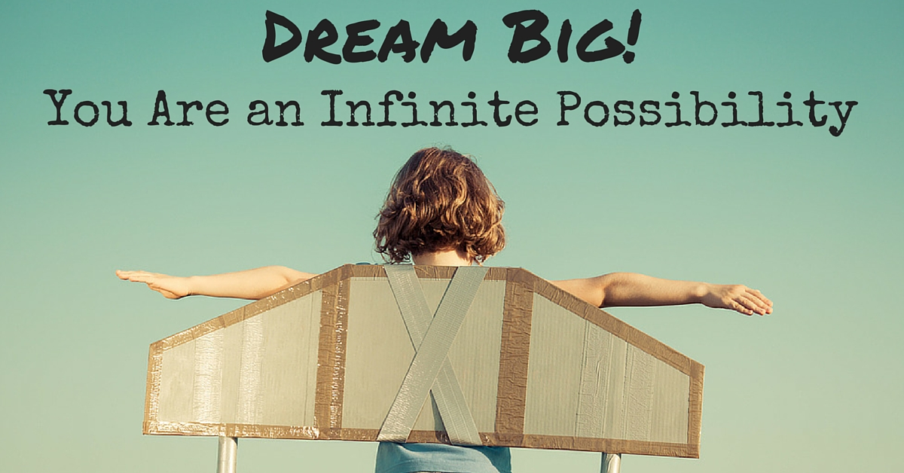
4. Be a contribution.
Imagine, you wake up every morning with the idea that you are a gift to others.
Contribution actually involves two practices: “1) declare yourself to be a contribution and 2) throw yourself into life as someone who makes a difference, accepting that you may not understand how or why.”
When you contribute, you forget about scarcity and dwell in the pond of abundance. You go from self-concern to making a difference for others.
Notice how the things you do help others. See and imagine how everything you do sends out ripples beyond the horizon.

Slide 8

5. Lead from any chair.
The conductor is not the only leader of an orchestra.
You can lead from any chair you’re sitting in. The act of leadership is not limited to people in leadership positions.
Anyone can lead – “the player who energizes the orchestra by communicating his newfound appreciation for the tasks of the conductor, or a parent who fashions in her own mind that her children desire to contribute, is exercising leadership of the most profound kind.”
It doesn’t matter who you are and where you sit; you can inspire and lead others from anywhere – even without a title or position.

Slide 9

6. Rule Number 6.
Rule Number 6 is a reminder to lighten up and not take yourself so seriously!
When you lighten up, you release yourself from egoistic and self-limiting beliefs.
“When we follow Rule number 6 and lighten up over our childish demands and entitlements, we are instantly transported into a remarkable universe. The new universe is cooperative in nature, and pulls for the realization of all our cooperative desires.”

Slide 10
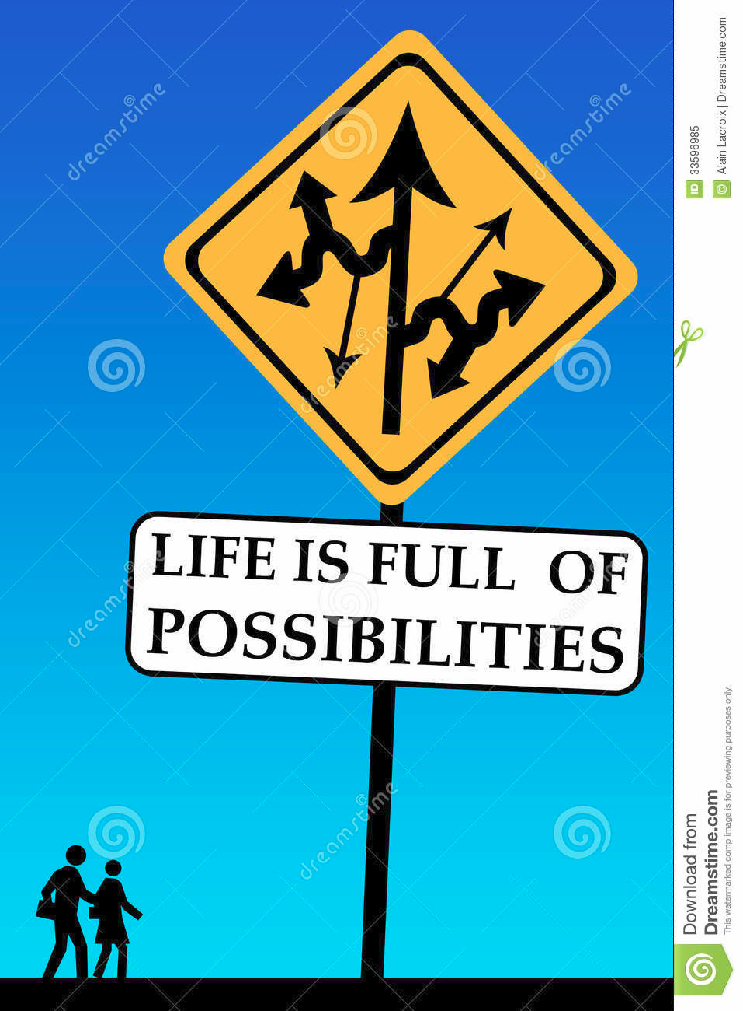
7. It is just the way things are.
This involves acceptance of what is, as well as presence and making the best of any situation.
When you’re present and not resisting the current situation, you are free to turn to the question, “What do we want to do from here?”
“…the capacity to be present to everything that is happening, without resistance, creates possibility. It creates possibility in the same way that, if you are far-sighted, finding your glasses revives your ability to read or remove a splinter from a child’s finger. At last you can see. You can leave behind the struggle to come to terms with what is in front of you, and move on.”
When you accept that things are the way they are, instead of complaining and resisting, you’re in a position to make the best of the situation. You’re allowed visions, dreams and appreciation for your current place. You’re more open to finding solutions or to making the best of the situation in your mind.
Being present with the present lets options and dreams come alive.
You’ll live in a place of freedom and possibilities when you’re comfortable with this moment.

Slide 11
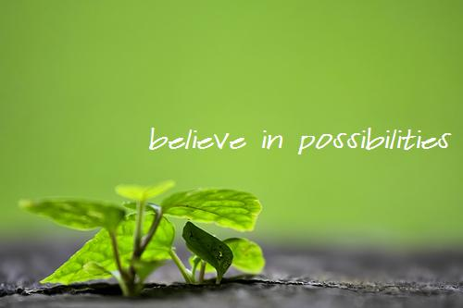
8. Give way to passion.
To give way to passion, “participate wholly. Allow yourself to be a channel to shape the stream of passion into a new expression for the world.”
Life has made many of us conformers, and has given us structure and limitations. Urban life highlights our rigidness and lack of vitality.
Your life will change when you “transcend the barriers of personal survival and become a unique conduit for its vital energy.”
Participate, engage and immerse yourself in your passions.

Slide 12

9. Light a spark.
This practice talks about inspiring others to pursue passion. It’s about spreading passion and lighting possibilities in the eyes and lives of others.
Imagine that others want to feel the same spark and electric sense of possibility that you feel. Be available and invite others who are ready to catch their spark and live their dreams.
When others say “no” to your idea or passion, they might be saying simply that they don’t see the same possibility you do.
Inspire others and share with them the very things that light you up.
Encourage and motivate others who are ready to join you.

Slide 13
10. Be the boss.
Declare, “I am the framework for everything that happens in my life.”
You can always grace yourself with responsibility for anything that happens in your life. You can always find within yourself the source of any problem you have.
This practice isn’t about blaming yourself or feeling at fault for your circumstances. It is about exploring the assumptions you make about what’s happening in your life and, ultimately, taking responsibility for them.
When you’re “being the boss,” so to speak, you question your assumptions, determine how your perspective or outlook led to the situation at hand and take responsibility for how you got there.
You’re not looking to place blame elsewhere or on others. You are doing the constructive work of understanding how you got to where you are – and without blaming yourself, either.
“Gracing yourself with responsibility for everything that happens in your life leaves your spirit whole, and leaves you free to choose again.”

Slide 14

11. Create frameworks for possibility.
Make a new distinction in the realm of possibility: one that is a powerful substitute for the current framework of meaning that is generating the downward spiral.
Don’t go with the flow toward an idea or concept that’s spiraling downward to the abyss.
Come up with bold, visionary missions and ideas that stand confidently in the world.
Find the courage and boldness to stand with your ideas and to face the direction where you’d like to lead people.
Look at the magical powers you have. Become more conscious of the way you use words, and define new frameworks of possibilities. Stand out and advocate for your bold ideas. Bring out the part in your audience that is the most contributory, most free and most open to participation.

Slide 15
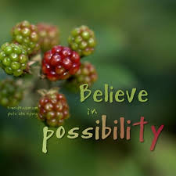
12. Tell the “we” story.
Can you move on from the story of “you and me” and “us and them,” and get to “we”?
Can you go from a place of division, conflict and hostility to a place of enthusiasm and togetherness? A place of friendship and cooperation?
The WE appears when, for the moment, we set aside the story of fear, competition, and struggle, and tell its story.
Ask: “‘What do WE want to have happen here?’
‘What’s best for US?’ – all of each of us, and all of all of us.
What’s OUR next step?”
Permit the barriers that separate us to dissolve and act from a place where all of us benefit, together.
All of us can find solutions that work for everyone. This involves taking the individual “I’s” and meshing them into a powerful, collective “we.” This is something we can practice from any chair, on any day, in any room or any environmen

Slide 16

Assignment C:
What if your teachers gave every student in the class an A at the beginning of the course?
To retain this grade, you have only to write a letter to the teacher, in as much detail as possible, explaining what you have done to earn the A, and how you have changed and grown by the end of the year. Also, you must describe to the teacher the kind of person you have become.
Select a teacher and subject and write a sample letter. What are you going to do to earn your A?

